Slide 1
The Fuck
Software Architecture 2015/2016
Authors:
Diana Moreira
Filipe Valente
Miguel Ferreira
Sara Pereira
Vanessa Silva

Slide 2
Description
The Fuck is a handy tool that allows its users to easily understand what went wrong with their console command. Keeping it short and simple, what it does is show them some alternatives to our last terminal input, (tries to match a rule for the previous command, creates a new command using the matched rule and runs it), and allowing them to make their own rules also.

Slide 4
Software Architecture
4+1 architectural view model describes the architecture of software-intensive systems, based on the use of multiple views. The views are used to describe the perspective of different stakeholders, such as end-users, programmers, software managers, integrators and system engineers. There are 5 views, each of them describing the expected behaviour of the system from the point of view of the different stakeholders: Scenarios, Logical View, Development View, Process View and Physical View.

Slide 5
Scenarios
The scenarios, or use cases, describe the possible interactions between user and system (different processes). In particular, it allows for validating all the following system views, with respect to compliance regarding the proposed functionalities.

Slide 6
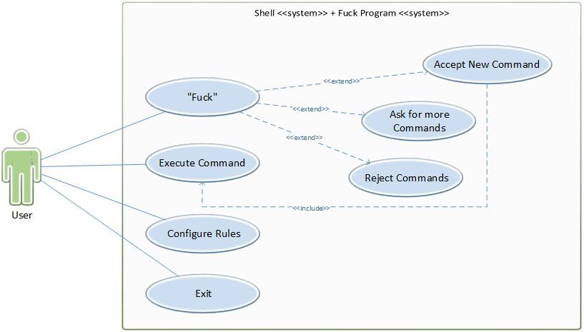

Slide 7
Logical View
This view is designed to address the end user's concerns regarding the system's insurance of their functional requirements. As such, it provides a basis for understanding the structure and organization of the overall system. The end result should be a mapping of the functionality in components that provide that functionality.

Slide 8
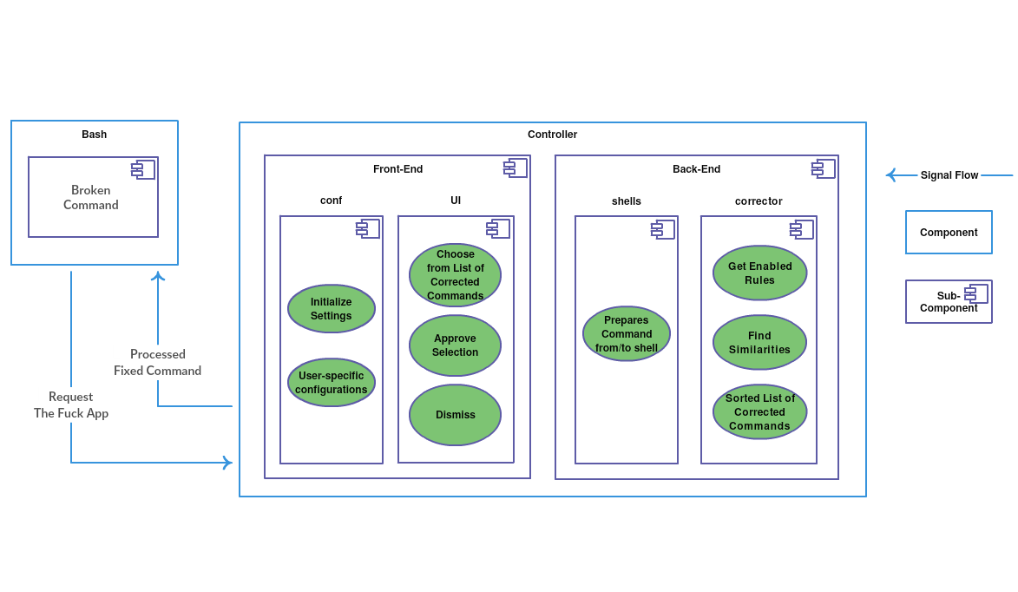

Slide 9
Process View
This view derives from the Logical view the concurrency and synchronization mechanisms underlying the software product, having the objective to provide a basis for understanding the process organization of the system.
The process view works with the dynamic aspects of the system, explains the system processes and how they communicate, and focuses on system runtime behavior.

Slide 10
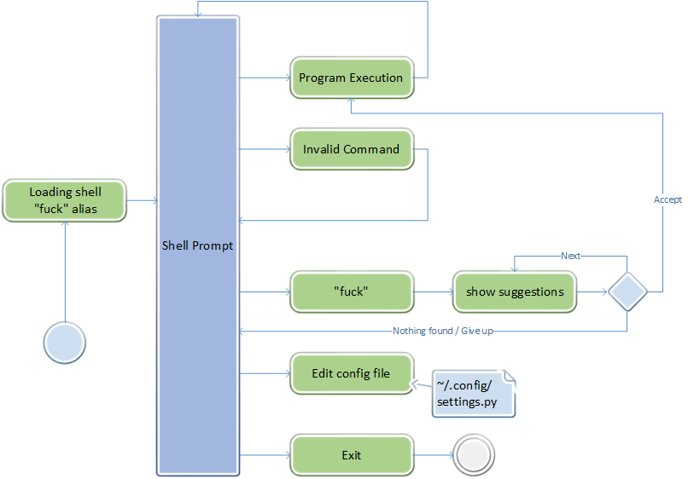

Slide 11
Development View
This view, also known as Implementation View, illustrates the system from a programmer's perspective and focuses on configuration management and internal organization of the software components in the development environment.

Slide 12
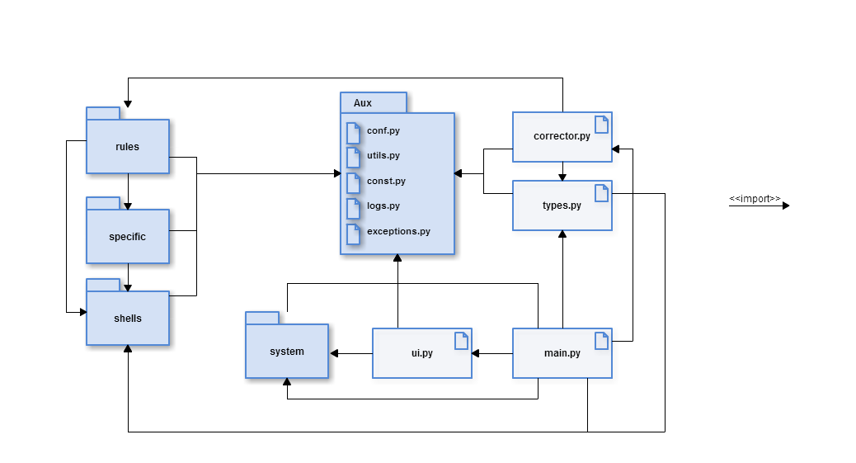

Slide 13




Contains rules enabled by default. Each rule is a special module with two functions:
match(command) - True when rule matched;
get_new_command(command) - return a list of fixed commands.
Utility functions to help matching specific rules. Provides information about existence
of apt-get or ArchLinux pacman, for instance, and predicts a fix for the command.
Converts shell specific command to sh compatible version, expands aliases and
environment variable.
Decides which terminal encoding to use and how to recognize key up/down movements in unix and Windows.

Slide 14
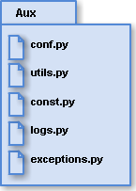
Auxiliary modules that deal with the program settings, errors, global variables, etc. We grouped these modules in a virtual package in order to make the diagram easier to understand.
The Aux package contains the following modules:
conf.py - configure the settings.
utils.py - define the necessary auxiliary functions for developing the program.
logs.py - deals with internal errors.
const.py - initializes through global variables the default options.
exceptions.py - displays an error message when the user enters a command that is not found.

Slide 15




Matches all enabled rules from rules package against current command and
return all available corrected commands.
Allows to choose from a list of corrected commands with arrow keys, approve selection with Enter or dismiss it with Ctrl+C
It's distributed in three classes:
Command(object) – parser of commands;
Rule(object) - inicializes rule with given fields;
CorrectedCommand(object) - run command from chosen rule by user.

Slide 16
Physical View
This view, also known as Deployment View, is concerned with the topology of software components on the physical layer, as well as the physical connections between them.

Slide 17
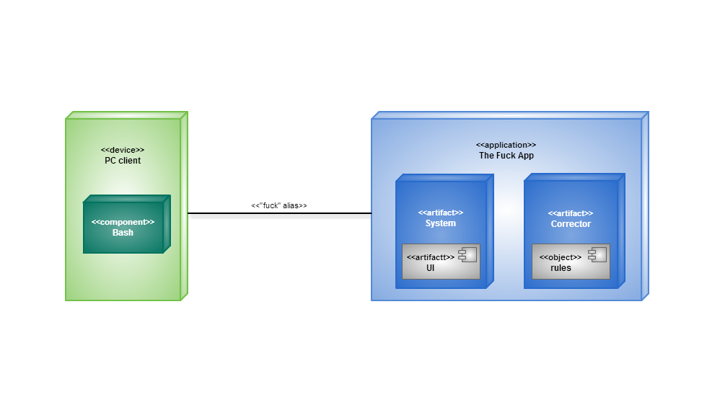

Slide 18
Discussion
There is a big gap between understanding what a program does, and understanding how a program works.
4+1 architectural view model de vista é um método prático para avaliar objetivamente este software, no que diz respeito às necessidades dos utilizadores (retratado como casos de uso), como agora detalhes:

Slide 19
The list of commands is consistent with the provided Logical View.
The available commands can be mapped to the diagram of the Process View.
The computation provided by the components in the Development View diagram enable the functionalities required by the Use Cases.
The physical nodes described in the Physical View diagram are sufficient for realizing the application proposed in all previous diagrams.

Slide 20
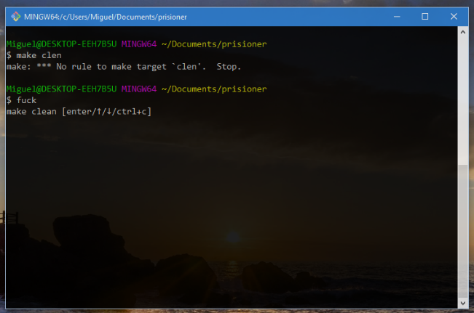
Code Contribution: Makefile RUle
We implemented a dynamic rule that, given a malformed/invalid make file invocation:
Parses the Makefile;
Retrieves it’s targets using regular expression matching;
Returns the most similarly named valid target.

Slide 21
Contributions
Regarding the contribution of each element to this report, the group believes that the work was equally distributed by the five elements, with the exception of the Makefile Rule code which was implemented by Miguel Ferreira.

